Slide 1



Digital Well-Being
Competence perspectives
Norman Rohner
Policy Officer

Slide 2

WHO WE ARE
We focus on all people who need to develop their digital skills.
We believe that everyone can benefit from digital transformation.
25 000
DIGITAL COMPETENCE CENTERS
We are a leading pan-European association based in Brussels, representing 100+ member organisations that work with 25,000 digital competence centers, providing training and advice to 2.3 million people in Europe every year.
2 300 000
PEOPLE SUPPORTED EVERY YEAR
We are a leading pan-European association based in Brussels, representing 84 member organisations that work with 25,000 digital competence centers, providing training and advice to 1.6 million people in Europe every year.
1 600 000
PEOPLE SUPPORTED EVERY YEAR
Basic
digital
skills
Advancedidigital skills
Digital media literacy
STE(A)M skills for society
Digital cultural heritage

Slide 3
FOCUS AREAS
We focus on all people who need to develop their digital skills.
We believe that everyone can benefit from digital transformation.
We are a leading pan-European association based in Brussels, representing 84 member organisations that work with 25,000 digital competence centers, providing training and advice to 1.6 million people in Europe every year.
1 600 000
Basic
digital
skills
Advanced digital skills
Digital media literacy
STE(A)M skills for society
Digital cultural heritage
PEOPLE SUPPORTED EVERY YEAR

Slide 4





Contributing authors:
Liliana Arroyo Moliner - Director General for Digital Society, Ministry of Business and Labor, Catalan Government
Vicky Charalambous, CARDET - Institute of Development
Veronique De Leneer, Maks vzw
Demos Michael, CARDET
Victoria Michaelidou, CARDET
Norman Röhner, ALL DIGITAL
Charalambos Vrasidas, CARDET - University of Nicosia
Belgium
Spain
Cyprus

Slide 5

Any interaction with digital technologies, whether they are active, passive, or creative, has an impact on individual and societal health and well-being. This impact can be positive or negative, and most often will share degrees of both. In addition, digital technologies have the potential to support and enhance individual and societal well-being.
We believe that a healthy and sustainable use of digital tools is an essential digital competence in itself, and underpins the ALL DIGITAL Manifesto for Enhancing Digital Competences across Europe’s principles of inclusivity, accessibility, and holisticness.
Digital Well-Being

Slide 6
Separation
Digital world developed as alternate reality
Escapism, anonymity, freedom
online vs offline
Barriers of access, understanding and awareness
“online disinhibition effect”
Connection
online activities have real world effects
Radicalisation
Socialising through digital tools
Bridging physical barriers
Inclusion and participation
Essential services
Merged worlds

Slide 7

Information and data literacy
5
Competence areas
Communication and collaboration
Digital content creation
Safety
Digital Competence Framework for Citizens (DigComp)
Problem solving

Slide 8
Safety
4.1 Protecting devices
4.2 Protecting personal data and privacy
4.3 Protecting health and well-being
4.4 Protecting the environment
21 Competences
Digital Competence Framework for Citizens (DigComp)

Slide 9
Foundation | 1 | Simple task, with guidance, remembering
 | 2 | Simple task, autonomy and guidance when needed, remembering
Intermediate | 3 | Well-defined and routine task, on my own, understanding
 | 4 | Tasks and non-routine problems, independent, understanding
Advanced | 5 | Different tasks and problems, guiding others, applying
 | 6 | Most appropriate tasks, adapt to others in context, evaluating
Highly specialised | 7 | Resolve complex problems, integrate into professional context, creating
 | 8 | Resolve complex problems, propose new ideas, creating
8
Proficiency levels
Digital Competence Framework for Citizens (DigComp)

Slide 10
1 Employment Scenario:
Use of a Twitter account to share information on my organisation
7: Create a digital campaign on possible health risk of using social media
2 Learning Scenario:
Use of the school’s digital learning platform to share information on interested topic
7: Create a blog on cyberbullying and social exclusion
2
Examples
of use
Digital Competence Framework for Citizens (DigComp)

Slide 11
Non-use
Digital addiction
Digital health applications
Cyberbullying
“digital disinhibition effect”
Risk of victimisation of vulnerable groups
Opportunities for participation
Manipulative and controlling practices
259
Examples of knowledge, skills and attidudes
Digital Competence Framework for Citizens (DigComp)

Slide 12

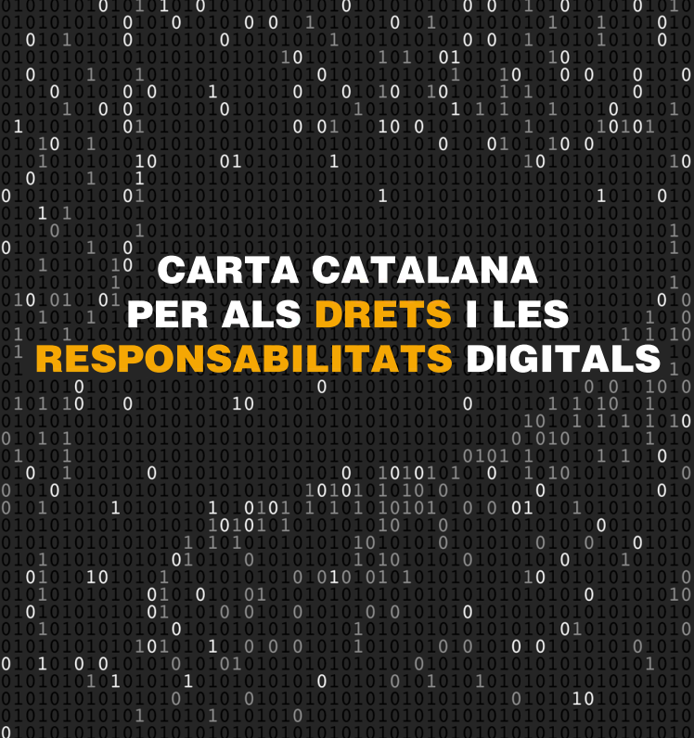

Catalan Charta of Digital Rights and Responsibilities

Slide 13



Goals:
Promoting Teacher Wellbeing
Advancing Teacher Professional Learning and Career Progression
Research & Data Collection
Policy Recommendations and Advocacy
Collaboration and Networking
Long-Term Systemic Impact
https://twco.prowproject.eu/
The TWCO and the project ProW are supported by the European Commission. The European Commission’s support for the production of this publication does not constitute an endorsement of the contents which reflects the views only of the authors, and the Commission cannot be held responsible for any use which may be made of the information contained therein. [Project Number: 626146-EPP-1-2020-2-EL-EPPKA3-PI-POLICY]

Slide 14
Digital device usage, screen time, and after-hours communication
Encouraging regular breaks
Ergonomic workstations that promote physical health
Resources and support for mental health
Flexible work arrangements
Training programs to enhance employees' digital competences
Promote physical
Equip employees with tools and resources for effective time management:
Cultivate a positive digital culture
Regular assessments
Workplaces
90% of jobs require digital skills = 90% of jobs involve interacting with digital tools

Slide 15

Young users of digital tools and intergenerational competence gaps
Digital Freedom
Socio-economic inequalities
Guidance for parents
Autonomously decide when to use digital devices
Impact of low income and low skills on well-being
Creating “dopamine moments”

Slide 16





Thank you!
+32 2 893 0201
norman.rohner@all-digital.org
Rue du Commerce 123, 1000 Brussels
www.all-digital.org

